Slide 1
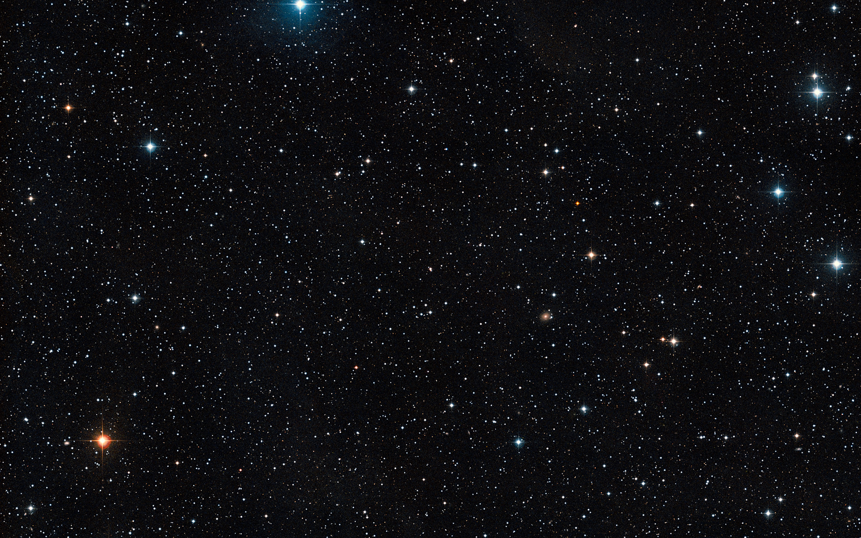
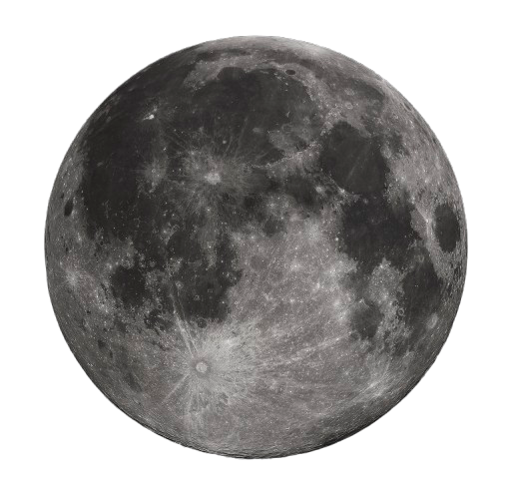

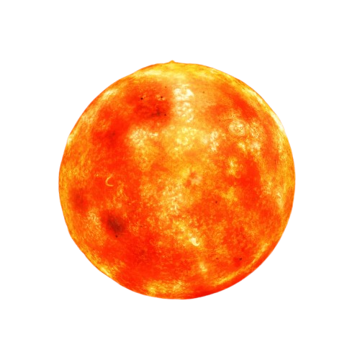

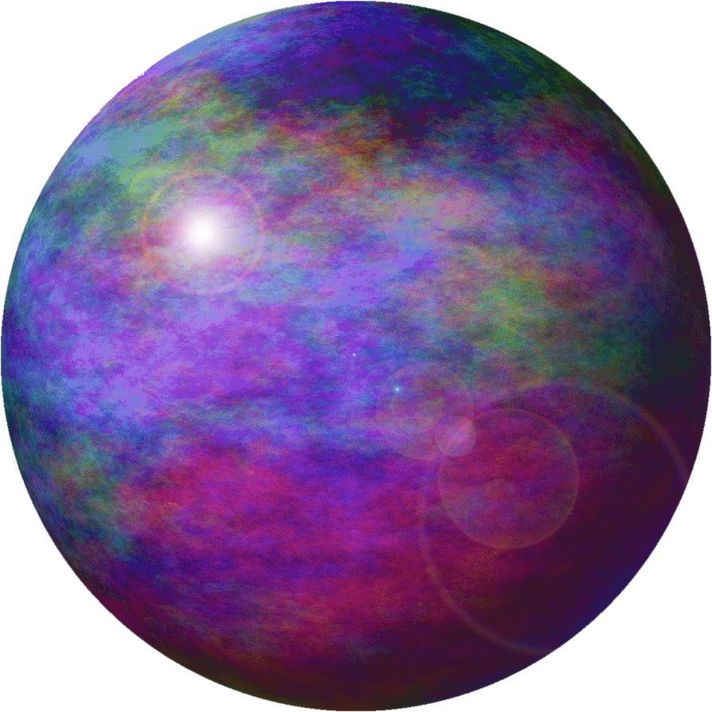
Interactive Orbital Simulation
THEME: ASTRO
Quentin Proulx, Alexandre Cabana, Micaêl Brouillet, Renaud Deschênes

Slide 2
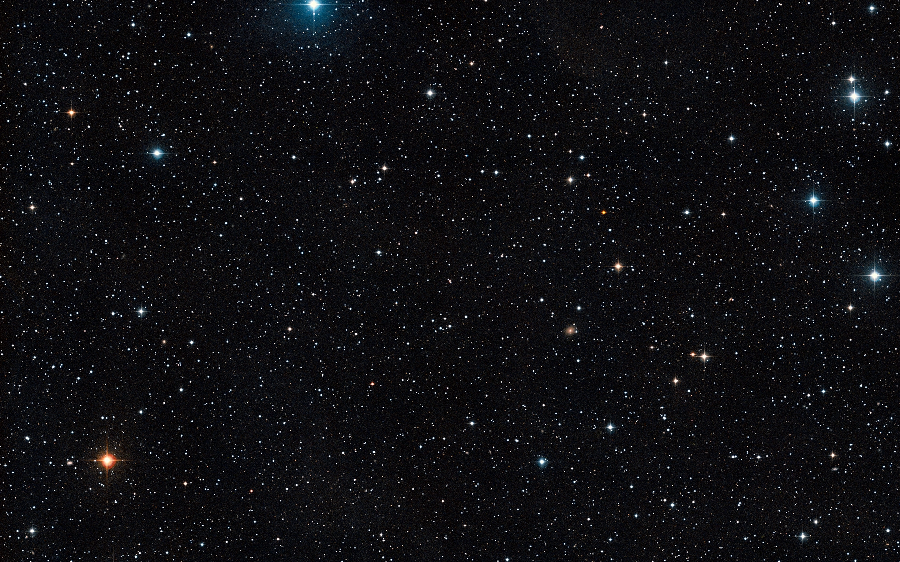
The Idea:
- Interactive Gravity Simulation that encourages the use of orbiting planets to display the nature and importance of the understanding of gravity in outer space travel.
- Our initial idea was to make this a fuel conservation game where you needed to use the planet’ orbits to reach a certain end goal.

Slide 3
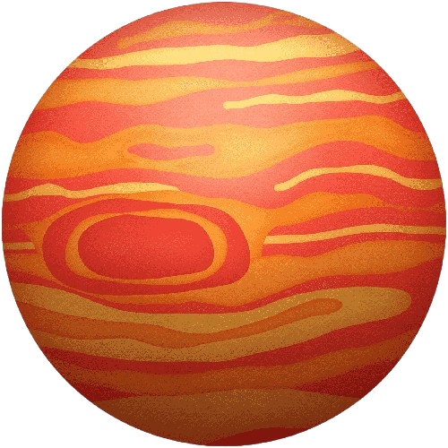
Important Concepts:
GRAVITY:
Our goal was to create a gravity system where integration of external forces (e.g. the propelling force of our ship) was easy.
SHIP MOVEMENT:
We wanted to create a ship movement system that interacted nicely with gravity, and we wanted to act realistically in an outer space-like environment.
INTERACTIVITY:
We wanted to make our simulation highly interactive, and fun to use. Our idea was to show, through a fun and fascinating means, how you can use gravity and orbits to help propel yourself through space more efficiently.

Slide 4
What We Used:
- We used Unity Engine to create our simulation due to its rendering capabilities and its ease of cooperation integration (through GitHub).
- Although Unity has a built-in physics engine, we opted against using it to create our own system of gravity, and acceleration.
- To communicate with each other and work together on the project, we used GitHub

Slide 5
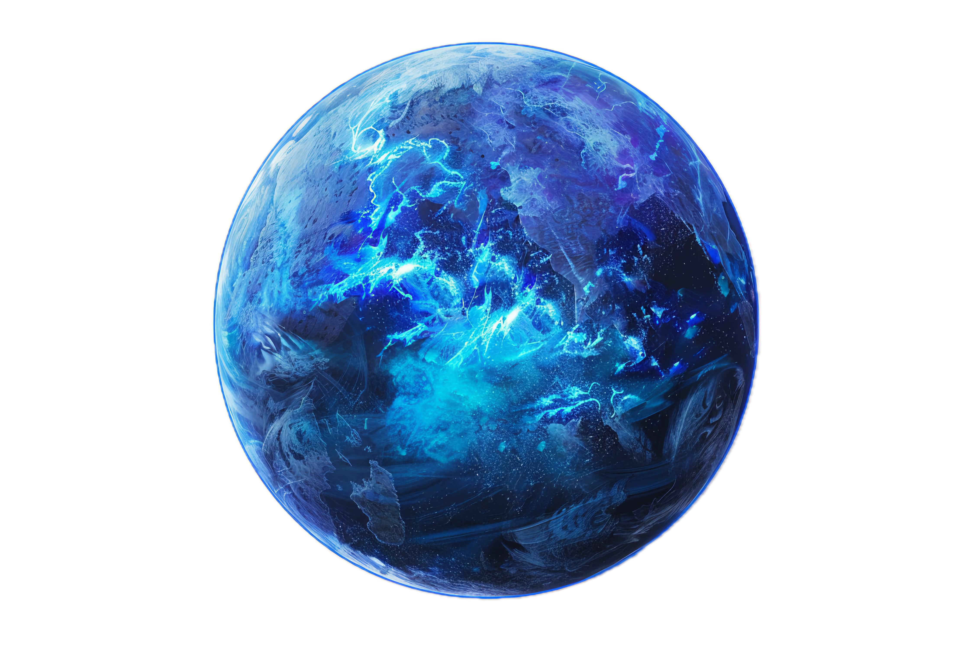
Our Difficulties:
The simplification of the application of external forces in our gravity system. Essentially, we wanted a system where we were able to very easily implement new features that could potentially impact gravity.
The rocket movement system was complicated to add. We wanted to implement a hard speed cap, but the angle was determined by the increase in speed due to the face that acceleration determined it.

Slide 6
Our Solutions:
To make it so we could implement whatever we wanted into the simulation, we simply made everything variable. For example, we a variable properties script for every planet in the game so that we could easily change their masses.
We spent a very long time trying to fix the rocket orientation problem; What we eventually did was make it so you could instantly change the rotation of the ship when you’d have reached your max speed, but we figured that was clunky, so we just ended up removing the speed cap all together.

Slide 7
The Rework:
On the final day, we decided to completely rework the movement and gravity systems to become much more fluid and immediately interactable.
We made it so that the use is able to actively see the effects that gravity has on their rocket using a trajectory line that predicts your future movements due to gravity.
Part of the reason that our rework worked so well was because Renaud had actually been developing it completely separately from our development since day one. This made it very easy to implement the big change.

Slide 8
- Through working in a team, we learned a lot about collaboration, and teamwork in an efficient and effective manner.
- We figured out that a divide and conquer method to solving problems is a very impactful method that will often get the results we want in an effective, timely fashion.
- We figured out that a divide and conquer method to solving problems is a very impactful method that will often get the results we want in an effective, timely fashion.
- On top of this, we learned a lot about the integration of physics systems in a digital environment.
What We Learned

